Slide 1
Advanced features
Introduction to WebGL 3D with HTML5 and Babylon.js

Slide 2


WHO ARE WE?
Geeks, web developers, 3D addicts
DAVID ROUSSET
DAVID CATUHE
TECHNICAL EVANGELIST
PRINCIPAL PROGRAM MANAGER
Twitter: @davrous
http://blogs.msdn.com/davrous
Twitter: @deltakosh
http://blogs.msdn.com/eternalcoding
Do not try to tune your speakers, the weird sound is due to French accent…

Slide 3


Course topics
Introduction to WebGL 3D with HTML5 and Babylon.js
Day One
01 | 3D on the Web: Understanding the Basics | 02 | WebGL Basics
03 | Using Babylon.js for Beginners | 04 | Understanding materials and inputs
Day Two
01 | Game Pipeline Integration with Babylon.js | 02 | Loading Assets
03 | Babylon.js: Advanced Features | 04 | Special Effects

Slide 4
TEASER
DEMO
Notes:
Espilit with Physic & gamepad

Slide 5
AGENDA
1
Picking meshes
2
Create your own shader
3
Animations
4
Physics simulation
5
CSG: Constructive Solid Geometries

Slide 6
Section One
Picking meshes

Slide 7
Picking
scene.pick()
Get a pickResult at given 2D coordinates
Can use a predicate to determine candidates
scene.onPointerDown
Raised by the scene
Give you the current picked mesh (if any)

Slide 8
USING SCENE.PICK()
DEMO

Slide 9
Manual ray casting
You can create rays manually
scene. createPickingRay (convert 2D to 3D ray)
new BABYLON.Ray(origin, destination)
Check intersection with Mesh.intersects(ray)

Slide 10
CASTING A RAY
DEMO

Slide 11
Section Two
Create your own shader

Slide 12
ShaderMaterial
Used to create custom shaders
Compatible with mesh.material
Based on GLSL shaders
You have to provide
Vertex shader code (text or DOM element)
Pixel shader code (text or DOM element)
Simple API to communicate with shaders (constants)

Slide 13
USING SHADERMATERIAL
DEMO

Slide 14
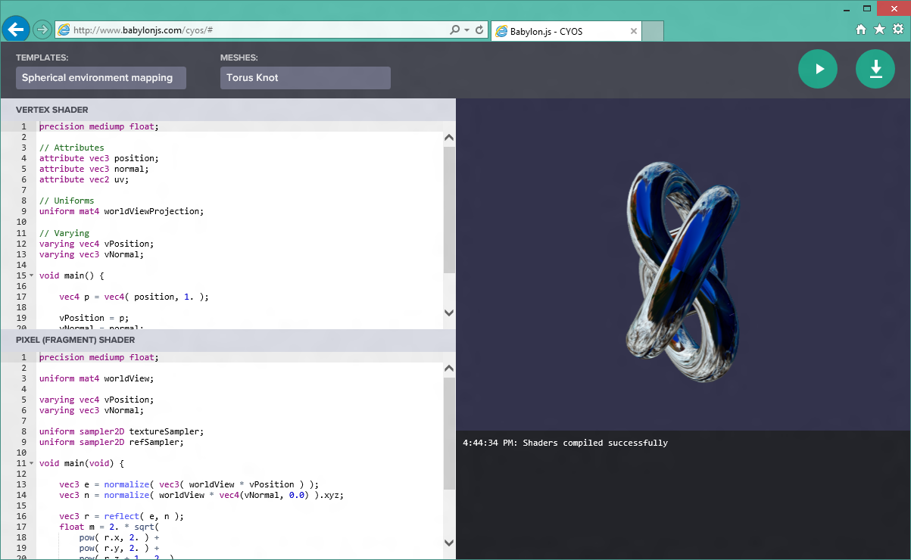
CYOS
Interactive shader creation tool
Learn by experimenting

Slide 15
USING CYOS
DEMO

Slide 16
Section Three
Animations

Slide 17
Manual animations
Using scene.registerBeforeRender()
Will be called on every frame
Use scene.getAnimationRatio() to synchronize animations

Slide 18
MANUAL ANIMATIONS
DEMO

Slide 19
Animations engine
Controlled by the scene
Based on keyframes
Linear interpolation by default
Custom interpolation supported
Animations can loop
Multi-animations supported
Supported types:
Number
Color3
Vector3
Matrix
Quaternion

Slide 20
USING ANIMATIONS
DEMO

Slide 21
Section Four
Physics simulation

Slide 22
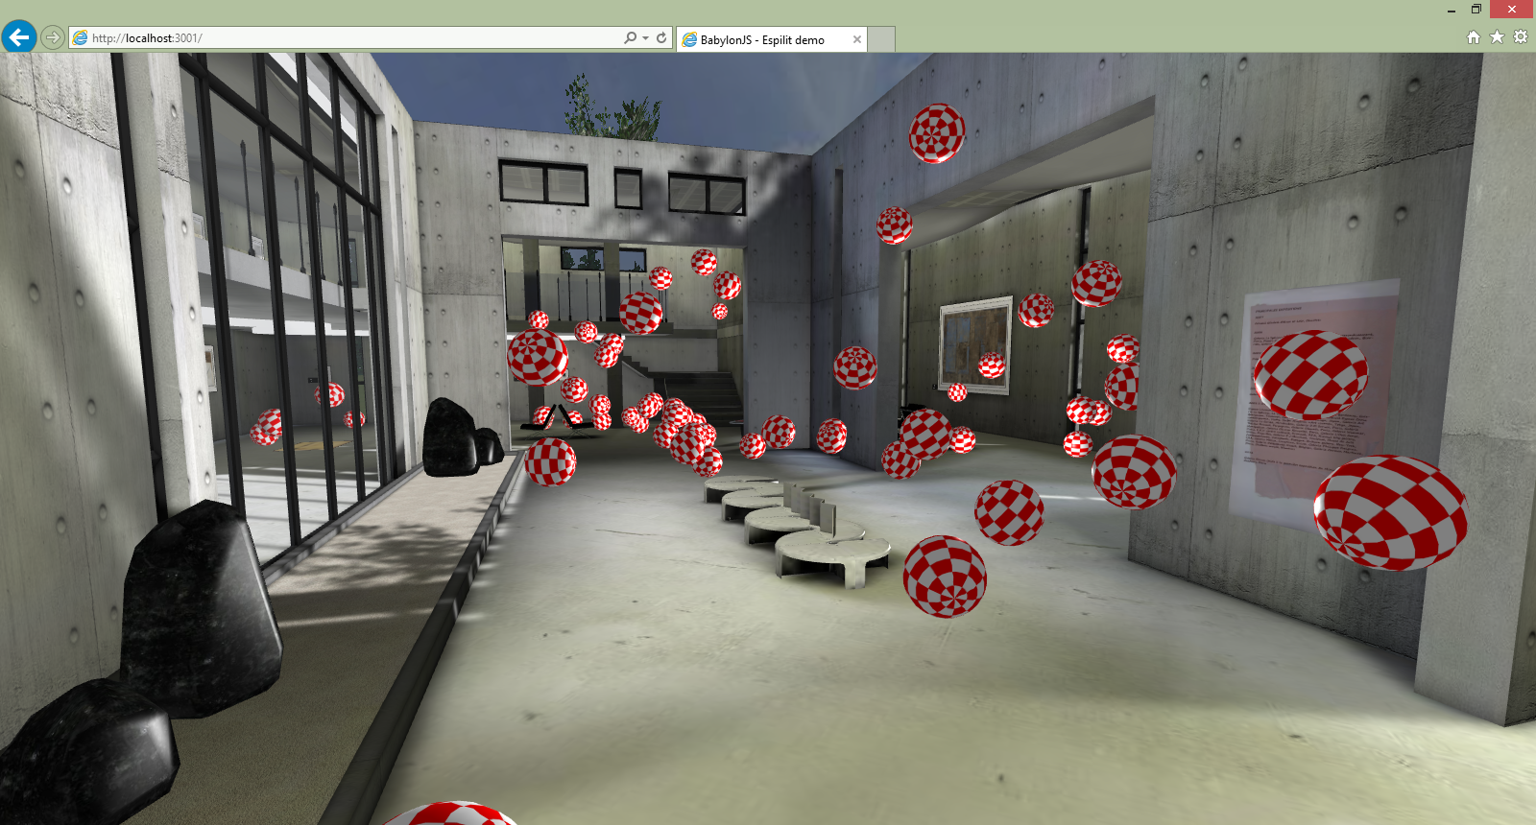
2 physics engines via a plug-in system
Based on Oimo.js by default & Canon.js available
Absolutely uncorrelated from the native collision engine
scene.enablePhysics(new BABYLON.Vector3(0, -10, 0), new BABYLON.OimoJSPlugin());

Slide 23
Set impostors
Choose the right impostor for your mesh:
BABYLON.PhysicsEngine.PlaneImposter
BABYLON.PhysicsEngine.BoxImposter
BABYLON.PhysicsEngine.SphereImposter
BABYLON.PhysicsEngine.CompoundImposter
To generate a physic effect on a mesh:
Let the gravity do its job
Collisions between meshes with physics enabled
Apply an impulse on the selected mesh at a given point
yourMesh.setPhysicsState(
BABYLON.PhysicsEngine.BoxImpostor,
{
mass: 0,
friction: 0.5,
restitution: 0.7
});
yourMesh.applyImpulse(direction, point); /* both BABYLON.Vector3 */

Slide 24
USING OIMO.JS WITH ESPILIT
DEMO

Slide 25
Section Five
CSG: Constructive Solid Geometries

Slide 26
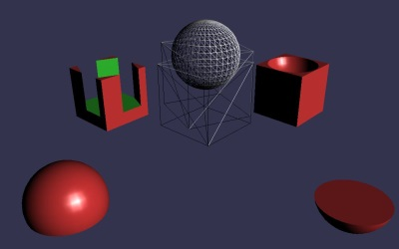
Boolean operations for meshes
You can combine or subtract meshes
Union
Difference
Intersection
More about the algorithm: http://en.wikipedia.org/wiki/Constructive_solid_geometry

Slide 27
USING CSG
DEMO

Slide 28
Going further
Creating a convincing world for your game with custom shaders, height maps and skyboxes
Picking collisions
Animation
Oimo - How to use a new Physics plugin
Adding your own physics engine plugin to Babylon.js

